Slide 1
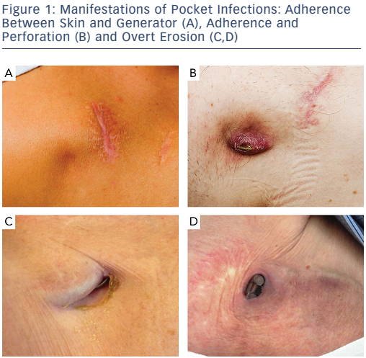
Esberg Kirkfeldt R, Brock Johansen J, Cosedis Nielsen J
Figure 1: Manifestations of Pocket Infections: Adherence Between Skin and Generator (A), Adherence and Perforation (B) and Overt Erosion (C,D)
Citation: Arrhythmia & Electrophysiology Review 2016;5(3):183–7
https://doi.org/10.15420/aer.2016:21:2

