Slide 1
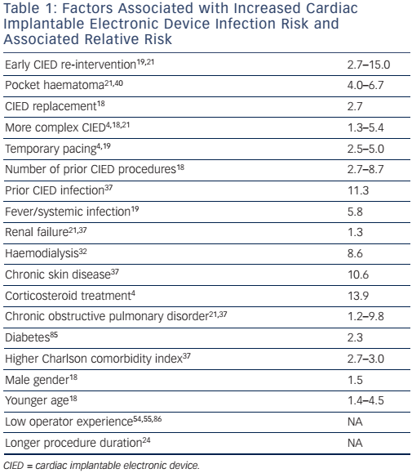
Esberg Kirkfeldt R, Brock Johansen J, Cosedis Nielsen J
Management of Cardiac Electronic Device Infections: Challenges and Outcomes
Citation: Arrhythmia & Electrophysiology Review 2016;5(3):183–7
https://doi.org/10.15420/aer.2016:21:2

