Slide 1
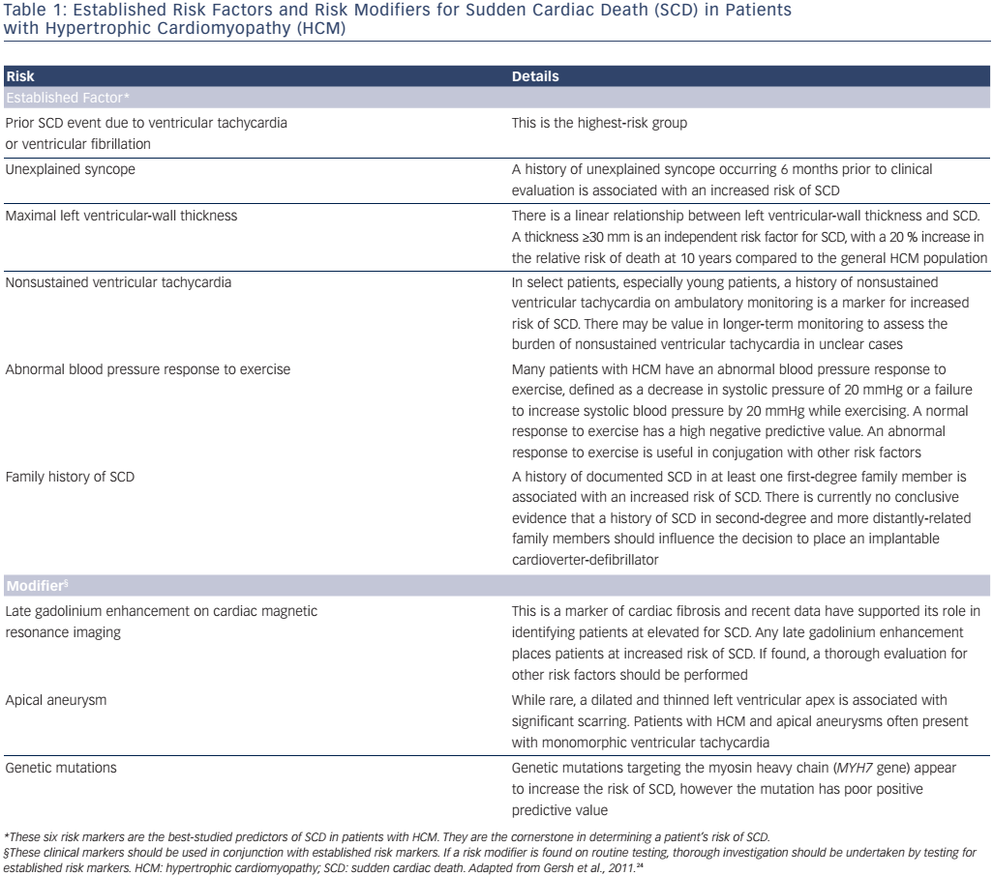
Trivedi A, Knight BP
Table 1: Established Risk Factors and Risk Modifiers for Sudden Cardiac Death (SCD) in Patients with Hypertrophic Cardiomyopathy (HCM)
Citation: Arrhythmia & Electrophysiology Review 2016;5(3):188–96
https://doi.org/10.15420/aer.2016:30:2

