Slide 1

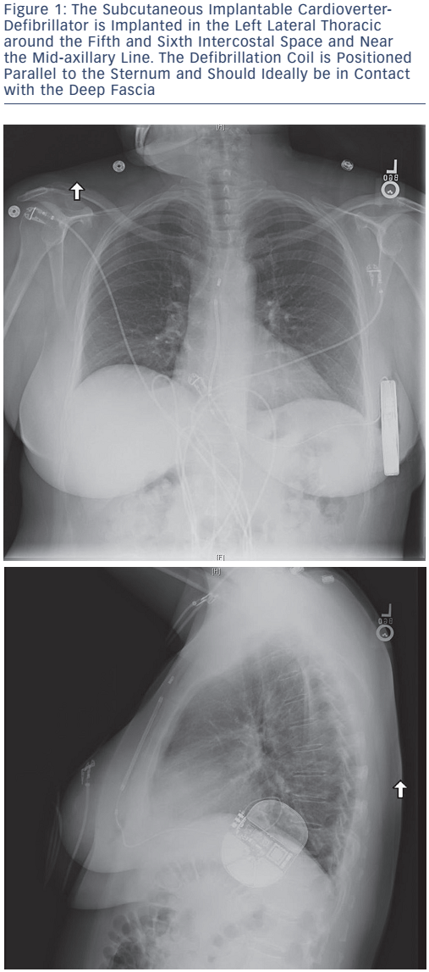
Trivedi A, Knight BP
ICD Therapy for Primary Prevention in Hypertrophic Cardiomyopathy
Citation: Arrhythmia & Electrophysiology Review 2016;5(3):188–96
https://doi.org/10.15420/aer.2016:30:2

