Slide 1
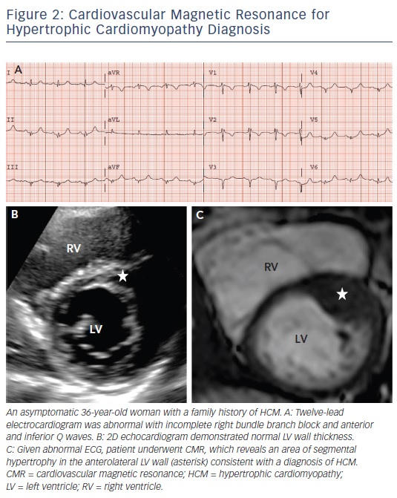
Rowin EJ, Maron MS
The Role of Cardiac MRI in the Diagnosis and Risk Stratification of Hypertrophic Cardiomyopathy
Citation: Arrhythmia & Electrophysiology Review 2016;5(3):197–202
https://doi.org/10.15420/aer.2016:13:3

