Slide 1
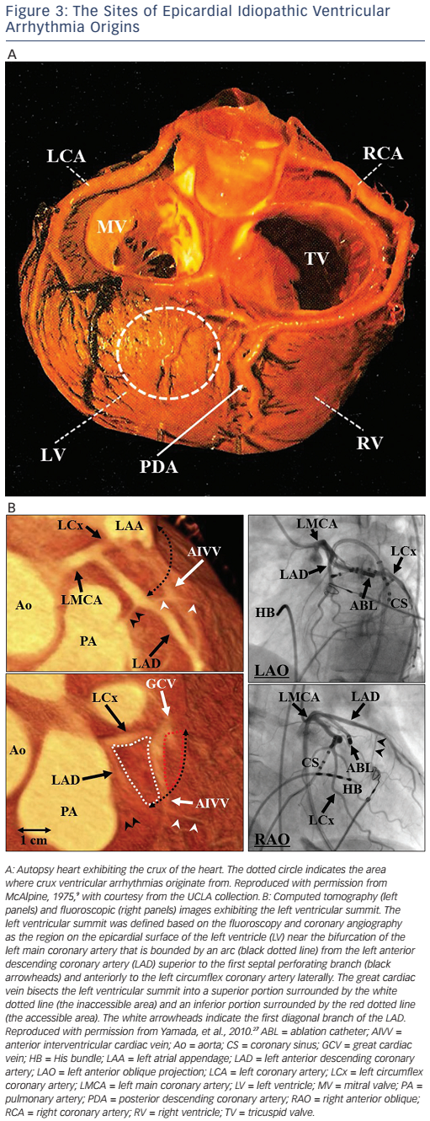
Yamada T, Kay GN
Anatomical Consideration in Catheter Ablation of Idiopathic Ventricular Arrhythmias
Citation: Arrhythmia & Electrophysiology Review 2016;5(3):203–9
https://doi.org/10.15420/aer.2016:31:2

