Slide 1
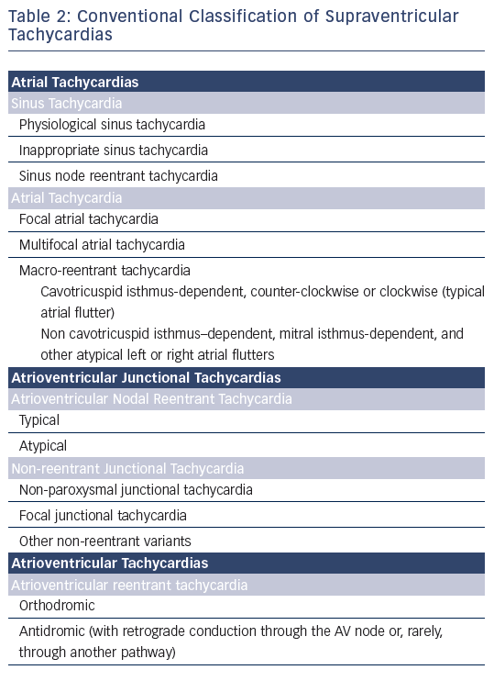
Katritsis DG, Boriani G, Cosio FG, Jaïs P, Hindricks G, Josephson ME, Keegan R, Knight BP, Kuck KH, Lane DA, Lip GY, Malmborg H, Oral H, Pappone C, Themistoclakis S, Wood KA, Young-Hoon K, Blomström-Lundqvist C
Table 2: Conventional Classification of Supraventricular Tachycardias
Citation: Arrhythmia & Electrophysiology Review 2016;5(3):210–4.
https://doi.org/10.15420/aer.2016:5.3.GL1

