Slide 1
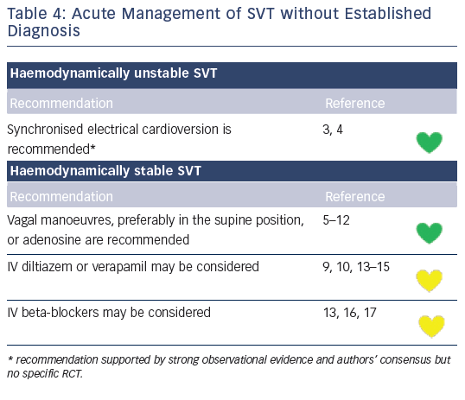
Katritsis DG, Boriani G, Cosio FG, Jaïs P, Hindricks G, Josephson ME, Keegan R, Knight BP, Kuck KH, Lane DA, Lip GY, Malmborg H, Oral H, Pappone C, Themistoclakis S, Wood KA, Young-Hoon K, Blomström-Lundqvist C
Table 4: Acute Management of SVT without Established Diagnosis
Citation: Arrhythmia & Electrophysiology Review 2016;5(3):210–4.
https://doi.org/10.15420/aer.2016:5.3.GL1

