Slide 1

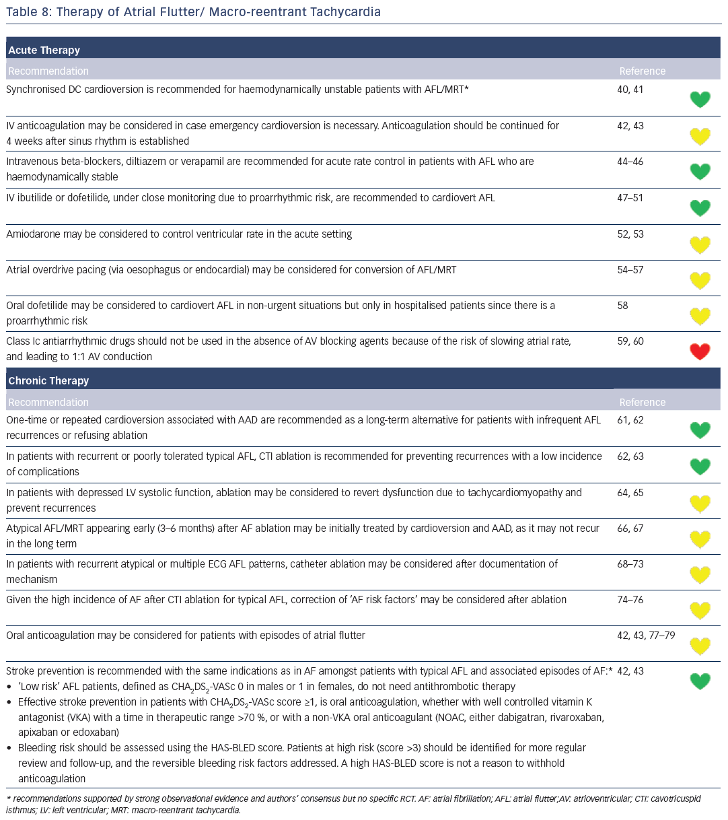
Katritsis DG, Boriani G, Cosio FG, Jaïs P, Hindricks G, Josephson ME, Keegan R, Knight BP, Kuck KH, Lane DA, Lip GY, Malmborg H, Oral H, Pappone C, Themistoclakis S, Wood KA, Young-Hoon K, Blomström-Lundqvist C
Table 8: Therapy of Atrial Flutter/ Macro-reentrant Tachycardia
Citation: Arrhythmia & Electrophysiology Review 2016;5(3):210–4.
https://doi.org/10.15420/aer.2016:5.3.GL1

