Slide 1

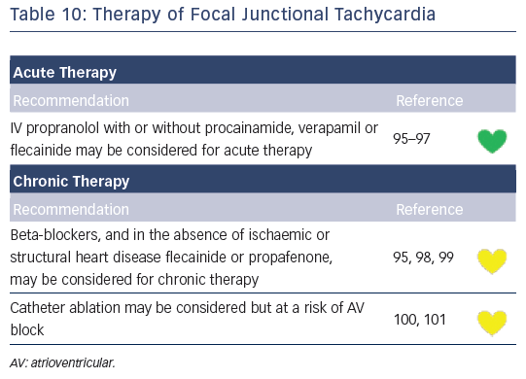
Katritsis DG, Boriani G, Cosio FG, Jaïs P, Hindricks G, Josephson ME, Keegan R, Knight BP, Kuck KH, Lane DA, Lip GY, Malmborg H, Oral H, Pappone C, Themistoclakis S, Wood KA, Young-Hoon K, Blomström-Lundqvist C
Table 10: Therapy of Focal Junctional Tachycardia
Citation: Arrhythmia & Electrophysiology Review 2016;5(3):210–4.
https://doi.org/10.15420/aer.2016:5.3.GL1

