Slide 1
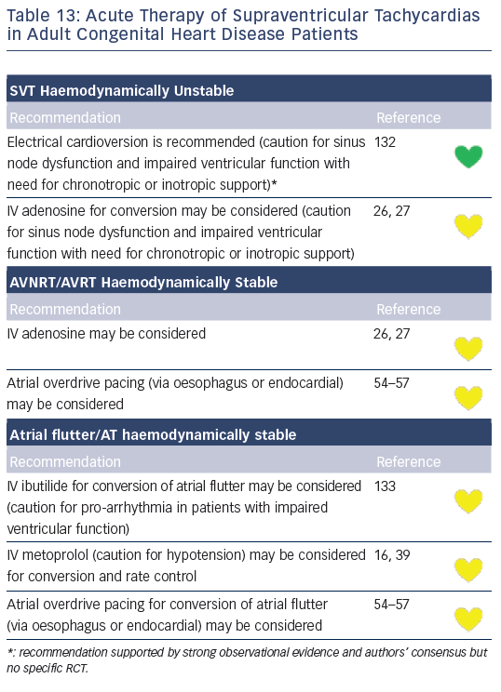
Katritsis DG, Boriani G, Cosio FG, Jaïs P, Hindricks G, Josephson ME, Keegan R, Knight BP, Kuck KH, Lane DA, Lip GY, Malmborg H, Oral H, Pappone C, Themistoclakis S, Wood KA, Young-Hoon K, Blomström-Lundqvist C
Table 13: Acute Therapy of Supraventricular Tachycardias in Adult Congenital Heart Disease Patients
Citation: Arrhythmia & Electrophysiology Review 2016;5(3):210–4.
https://doi.org/10.15420/aer.2016:5.3.GL1

