Slide 1

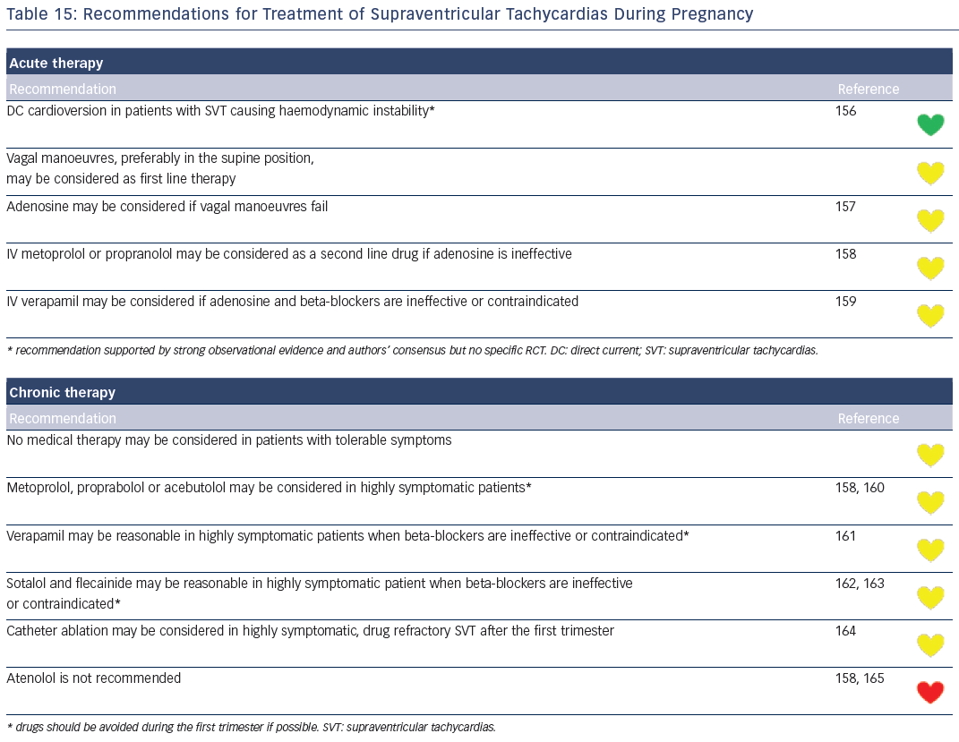
Katritsis DG, Boriani G, Cosio FG, Jaïs P, Hindricks G, Josephson ME, Keegan R, Knight BP, Kuck KH, Lane DA, Lip GY, Malmborg H, Oral H, Pappone C, Themistoclakis S, Wood KA, Young-Hoon K, Blomström-Lundqvist C
Table 15: Recommendations for Treatment of Supraventricular Tachycardias During Pregnancy
Citation: Arrhythmia & Electrophysiology Review 2016;5(3):210–4.
https://doi.org/10.15420/aer.2016:5.3.GL1

