Slide 1
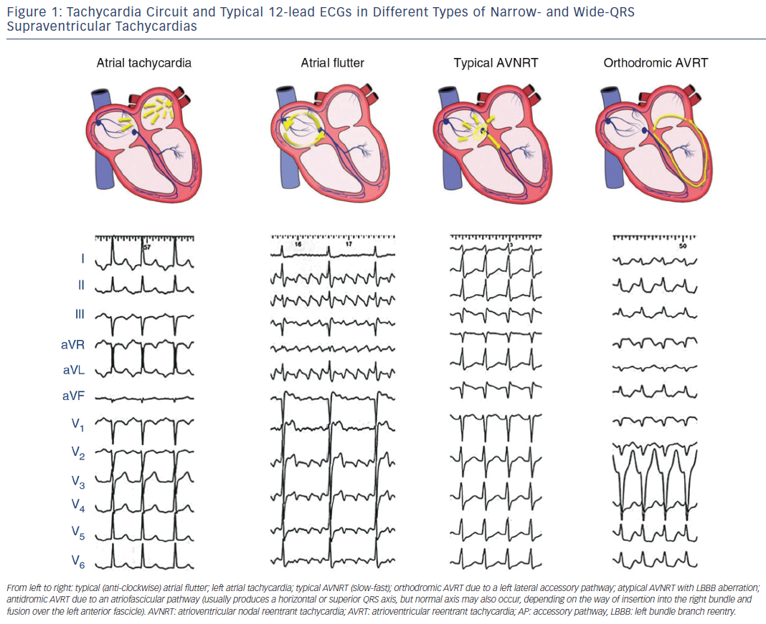
Katritsis DG, Boriani G, Cosio FG, Jaïs P, Hindricks G, Josephson ME, Keegan R, Knight BP, Kuck KH, Lane DA, Lip GY, Malmborg H, Oral H, Pappone C, Themistoclakis S, Wood KA, Young-Hoon K, Blomström-Lundqvist C
Figure 1: Tachycardia Circuit and Typical 12-lead ECGs in Different Types of Narrow- and Wide-QRS Supraventricular Tachycardias
Citation: Arrhythmia & Electrophysiology Review 2016;5(3):210–4.
https://doi.org/10.15420/aer.2016:5.3.GL1

