Slide 1

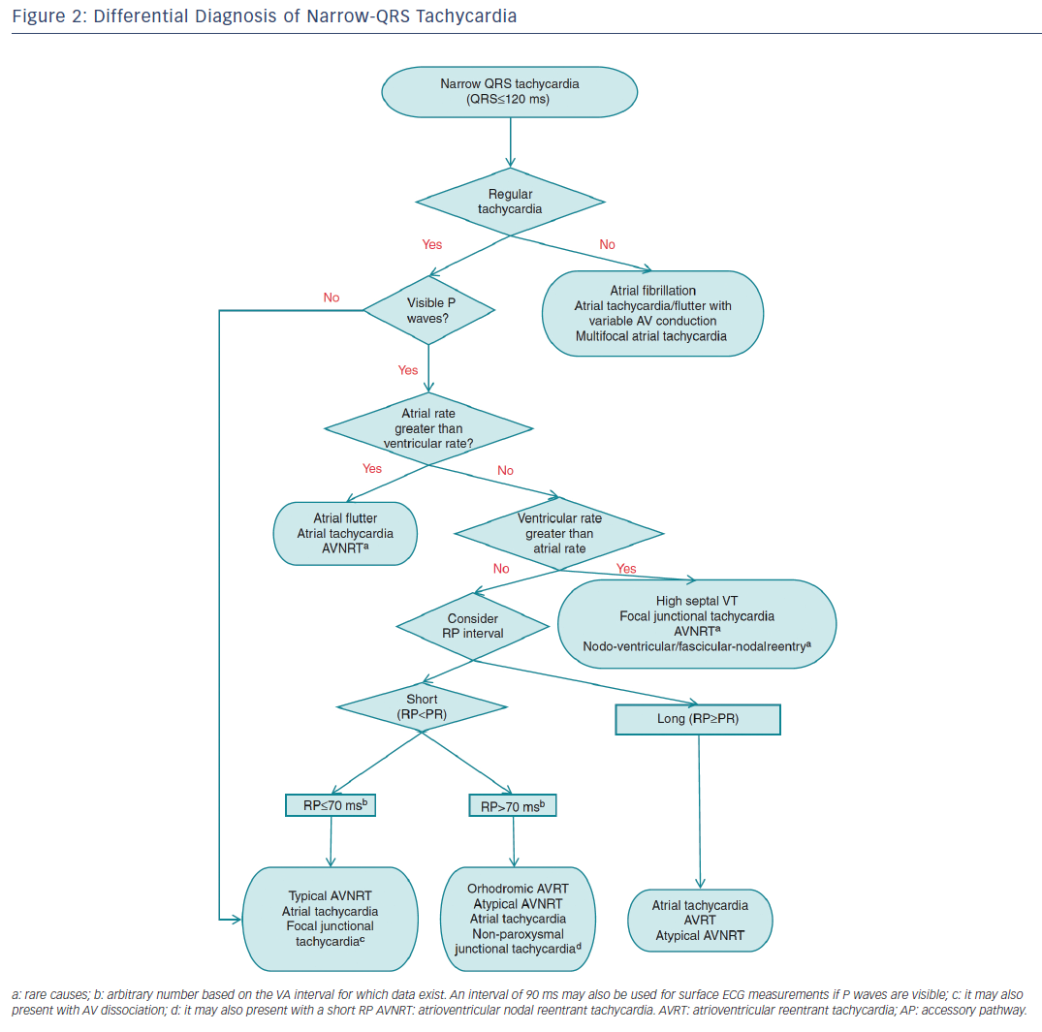
Katritsis DG, Boriani G, Cosio FG, Jaïs P, Hindricks G, Josephson ME, Keegan R, Knight BP, Kuck KH, Lane DA, Lip GY, Malmborg H, Oral H, Pappone C, Themistoclakis S, Wood KA, Young-Hoon K, Blomström-Lundqvist C
Figure 2: Differential Diagnosis of Narrow-QRS Tachycardia
Citation: Arrhythmia & Electrophysiology Review 2016;5(3):210–4.
https://doi.org/10.15420/aer.2016:5.3.GL1

