Slide 1
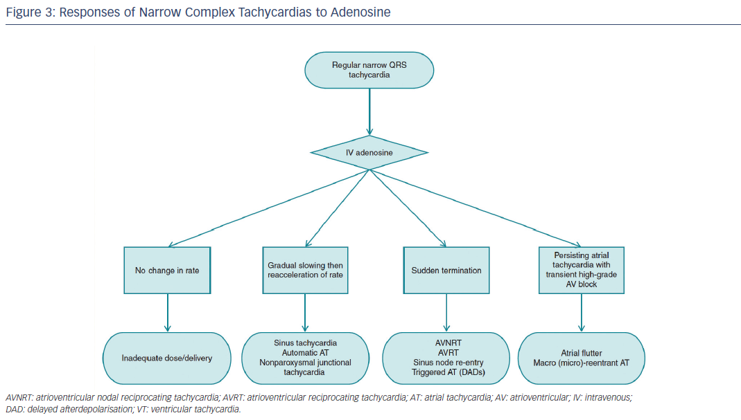
Katritsis DG, Boriani G, Cosio FG, Jaïs P, Hindricks G, Josephson ME, Keegan R, Knight BP, Kuck KH, Lane DA, Lip GY, Malmborg H, Oral H, Pappone C, Themistoclakis S, Wood KA, Young-Hoon K, Blomström-Lundqvist C
Figure 3: Responses of Narrow Complex Tachycardias to Adenosine
Citation: Arrhythmia & Electrophysiology Review 2016;5(3):210–4.
https://doi.org/10.15420/aer.2016:5.3.GL1

