Slide 1
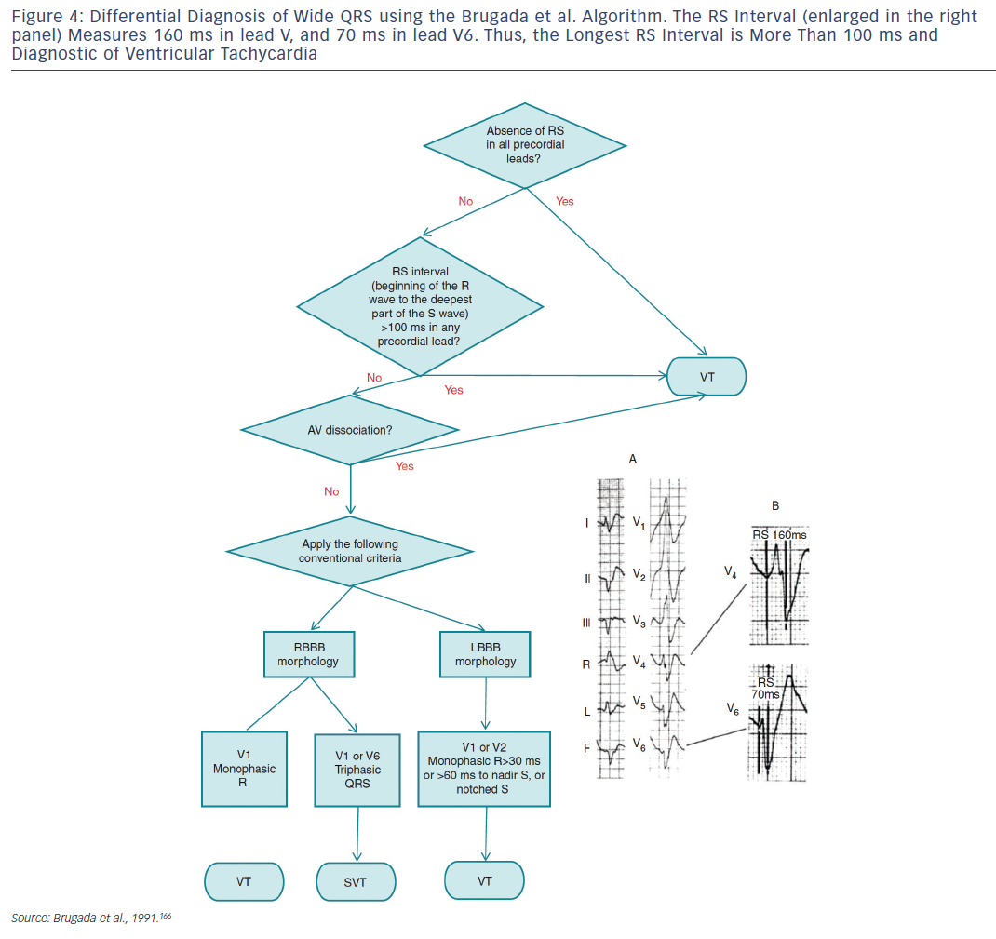
Katritsis DG, Boriani G, Cosio FG, Jaïs P, Hindricks G, Josephson ME, Keegan R, Knight BP, Kuck KH, Lane DA, Lip GY, Malmborg H, Oral H, Pappone C, Themistoclakis S, Wood KA, Young-Hoon K, Blomström-Lundqvist C
Figure 4: Differential Diagnosis of Wide QRS using the Brugada et al. Algorithm
Citation: Arrhythmia & Electrophysiology Review 2016;5(3):210–4.
https://doi.org/10.15420/aer.2016:5.3.GL1

