Slide 1

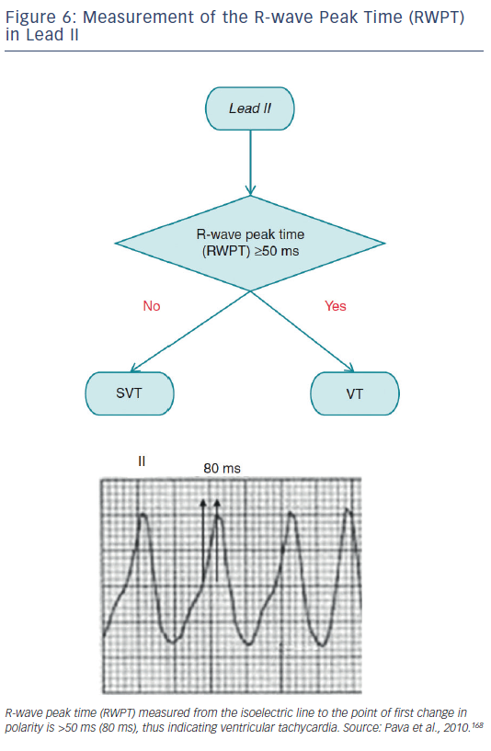
Katritsis DG, Boriani G, Cosio FG, Jaïs P, Hindricks G, Josephson ME, Keegan R, Knight BP, Kuck KH, Lane DA, Lip GY, Malmborg H, Oral H, Pappone C, Themistoclakis S, Wood KA, Young-Hoon K, Blomström-Lundqvist C
Figure 6: Measurement of the R-wave Peak Time (RWPT) in Lead II
Citation: Arrhythmia & Electrophysiology Review 2016;5(3):210–4.
https://doi.org/10.15420/aer.2016:5.3.GL1

