Slide 1

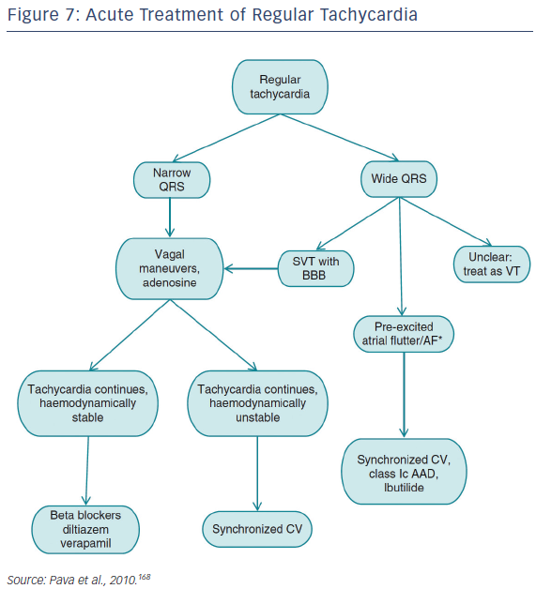
Katritsis DG, Boriani G, Cosio FG, Jaïs P, Hindricks G, Josephson ME, Keegan R, Knight BP, Kuck KH, Lane DA, Lip GY, Malmborg H, Oral H, Pappone C, Themistoclakis S, Wood KA, Young-Hoon K, Blomström-Lundqvist C
Figure 7: Acute Treatment of Regular Tachycardia
Citation: Arrhythmia & Electrophysiology Review 2016;5(3):210–4.
https://doi.org/10.15420/aer.2016:5.3.GL1

