Slide 1
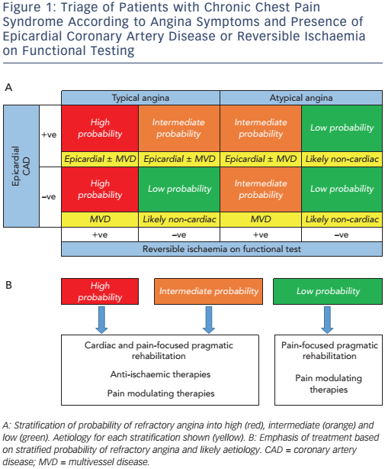
Cheng K, Sainsbury P, Fisher M, de Silva R
Figure 1: Triage of Patients with Chronic Chest Pain Syndrome According to Angina Symptoms and Presence of Epicardial Coronary Artery Disease or Reversible Ischaemia on Functional Testing
Citation: European Cardiology Review 2016;11(2):69–76
https://doi.org/10.15420/ecr.2016:26:1

