Slide 1
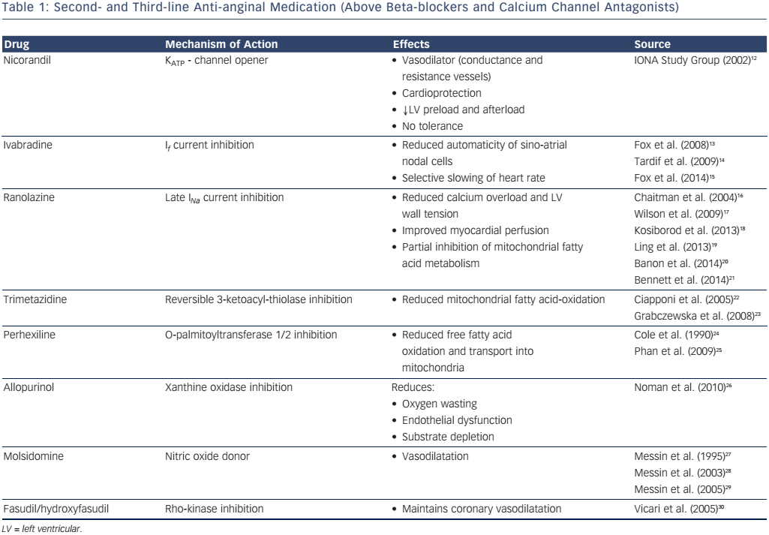
Cheng K, Sainsbury P, Fisher M, de Silva R
Table 1: Second- and Third-line Anti-anginal Medication (Above Beta-blockers and Calcium Channel Antagonists)
Citation: European Cardiology Review 2016;11(2):69–76
https://doi.org/10.15420/ecr.2016:26:1

