Slide 1
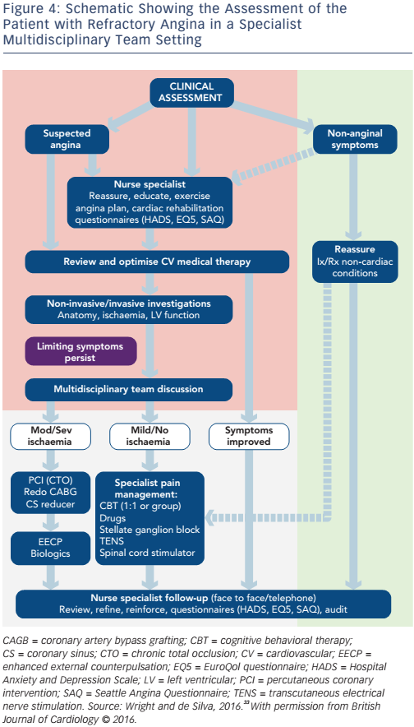
Cheng K, Sainsbury P, Fisher M, de Silva R
Figure 4: Schematic Showing the Assessment of the Patient with Refractory Angina in a Specialist Multidisciplinary Team Setting
Citation: European Cardiology Review 2016;11(2):69–76
https://doi.org/10.15420/ecr.2016:26:1

