Slide 1
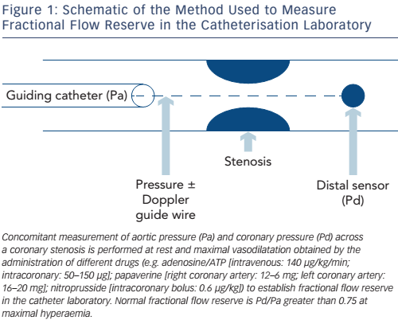
Balanescu S
Figure 1: Schematic of the Method Used to Measure Fractional Flow Reserve in the Catheterisation Laboratory
Citation: European Cardiology Review 2016;11(2):77–82
https://doi.org/10.15420/ecr/2016:24:2

