Slide 1
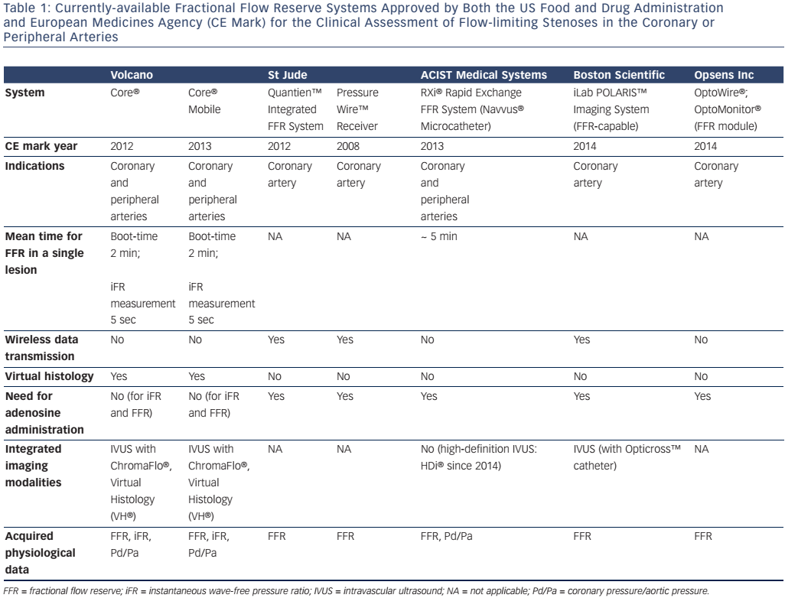
Balanescu S
Table 1: Currently-available Fractional Flow Reserve Systems
Citation: European Cardiology Review 2016;11(2):77–82
https://doi.org/10.15420/ecr/2016:24:2

