Slide 1
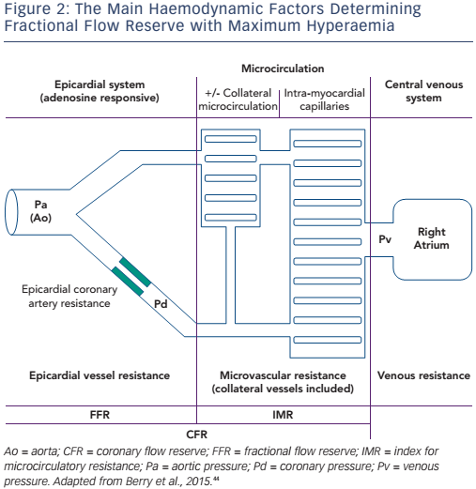
Balanescu S
Figure 2: The Main Haemodynamic Factors Determining Fractional Flow Reserve with Maximum Hyperaemia
Citation: European Cardiology Review 2016;11(2):77–82
https://doi.org/10.15420/ecr/2016:24:2

