Slide 1
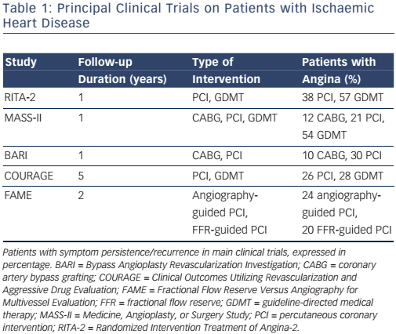
Huqi A, Guarini G, Morrone D, Marzilli M
Table 1: Principal Clinical Trials on Patients with Ischaemic Heart Disease
Citation: European Cardiology Review 2016;11(2):85–9
https://doi.org/10.15420/ecr.2016:27:2

