Slide 1
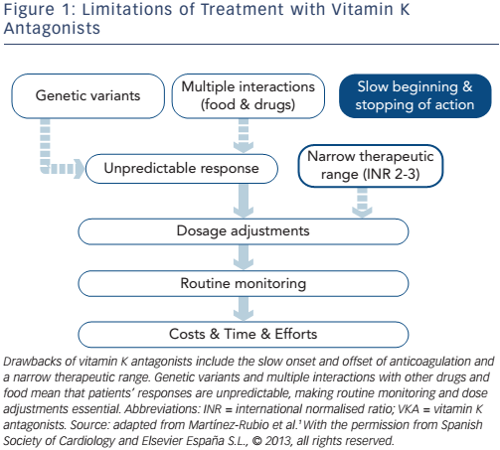
Martínez-Rubio A, DiazNuila-Alcazar M, Soria Cadena A, Martínez-Torrecilla R
Figure 1: Limitations of Treatment with Vitamin K Antagonists
Citation: European Cardiology Review 2016;11(2):118–22
https://doi.org/10.15420/ecr.2016:30:1

