Slide 1
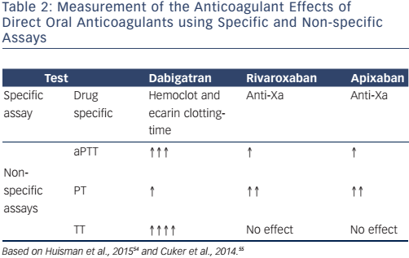
Martínez-Rubio A, DiazNuila-Alcazar M, Soria Cadena A, Martínez-Torrecilla R
Table 2: Measurement of the Anticoagulant Effects of Direct Oral Anticoagulants using Specific and Non-specific Assays
Citation: European Cardiology Review 2016;11(2):118–22
https://doi.org/10.15420/ecr.2016:30:1

