Slide 1
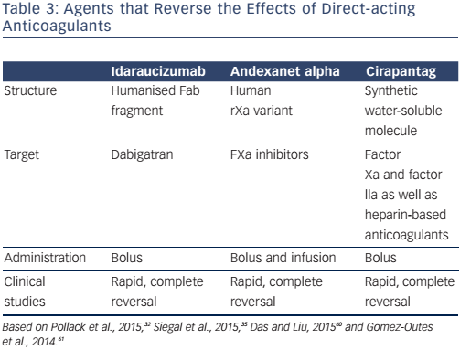
Martínez-Rubio A, DiazNuila-Alcazar M, Soria Cadena A, Martínez-Torrecilla R
Table 3: Agents that Reverse the Effects of Direct-acting Anticoagulants
Citation: European Cardiology Review 2016;11(2):118–22
https://doi.org/10.15420/ecr.2016:30:1

