Slide 1
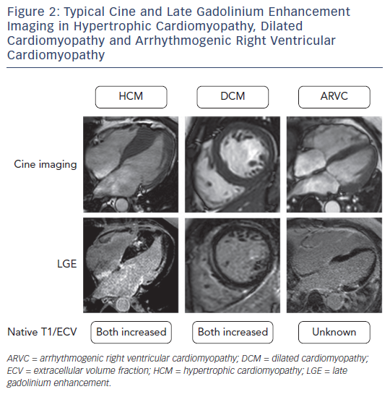
Swoboda PP, McDiarmid AK, Page SP, Greenwood JP, Plein S
Figure 2: Typical Cine and Late Gadolinium Enhancement Imaging in Hypertrophic Cardiomyopathy, Dilated Cardiomyopathy and Arrhythmogenic Right Ventricular Cardiomyopathy
Citation: European Cardiology Review 2016;11(2):96–101
https://doi.org/10.15420/ecr/2016:28:2

