Slide 1
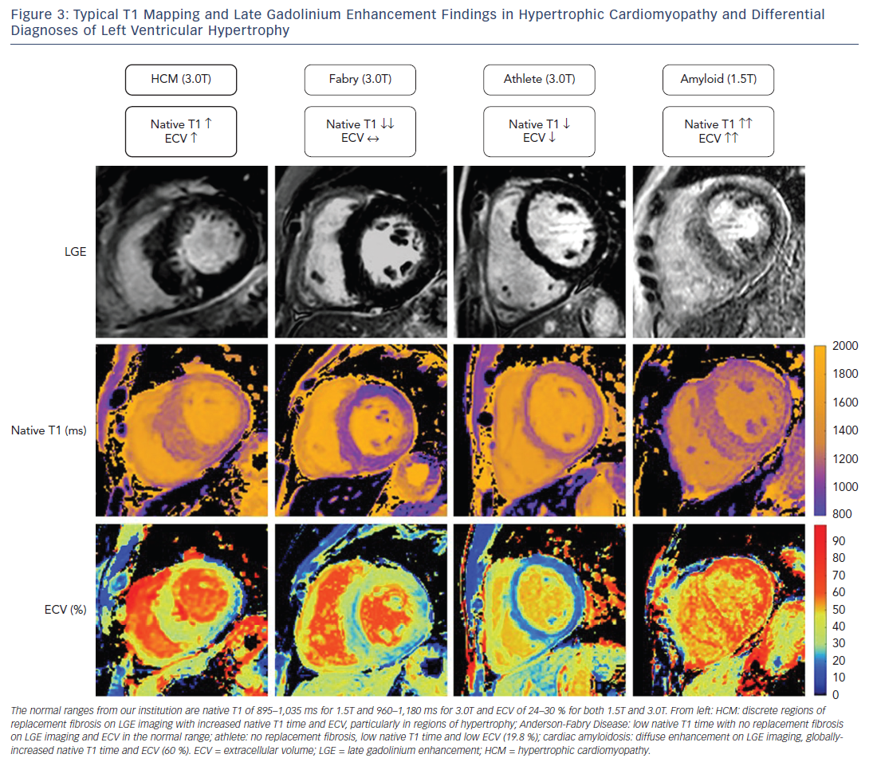
Swoboda PP, McDiarmid AK, Page SP, Greenwood JP, Plein S
Figure 3: Typical T1 Mapping and Late Gadolinium Enhancement Findings in Hypertrophic Cardiomyopathy and Differential&lt;br /&gt;&#10;Diagnoses of Left Ventricular Hypertrophy
Citation: European Cardiology Review 2016;11(2):96–101
https://doi.org/10.15420/ecr/2016:28:2

