Slide 1
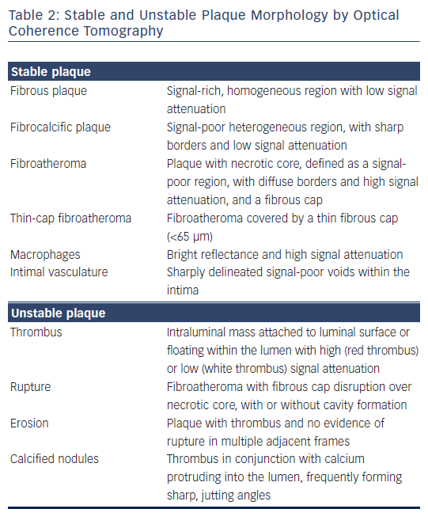
Toutouzas K, Karanasos A, Tousoulis D
Table 2: Stable and Unstable Plaque Morphology by Optical Coherence Tomography
Citation: European Cardiology Review 2016;11(2):90–5
https://doi.org/10.15420/ecr.2016:29:2

