Slide 1
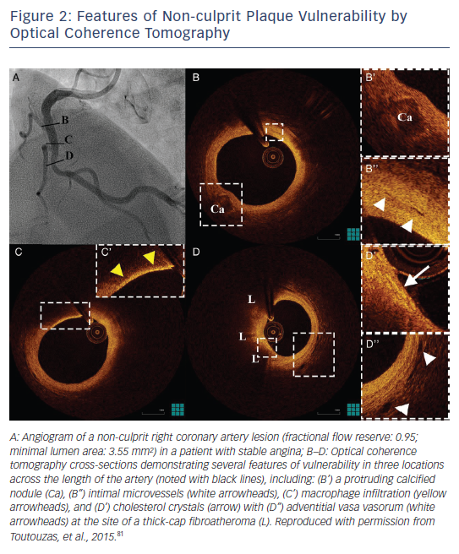
Toutouzas K, Karanasos A, Tousoulis D
Figure 2: Features of Non-culprit Plaque Vulnerability by Optical Coherence Tomography
Citation: European Cardiology Review 2016;11(2):90–5
https://doi.org/10.15420/ecr.2016:29:2

