Slide 1
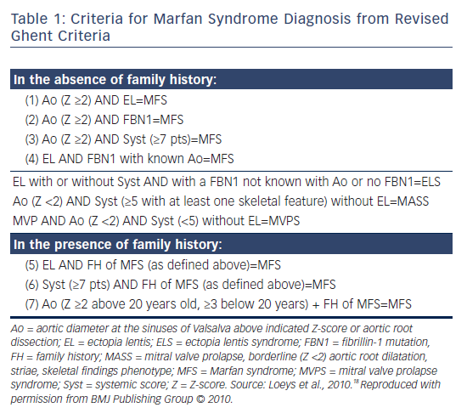
Isekame Y, Gati S, Aragon-Martin JA, Bastiaenen R, Kondapally Seshasai SR, Child A
Table 1: Criteria for Marfan Syndrome Diagnosis from Revised Ghent Criteria
Citation: European Cardiology Review 2016;11(2):102–10
https://doi.org/10.15420/ecr/2016:19:2

