Slide 1
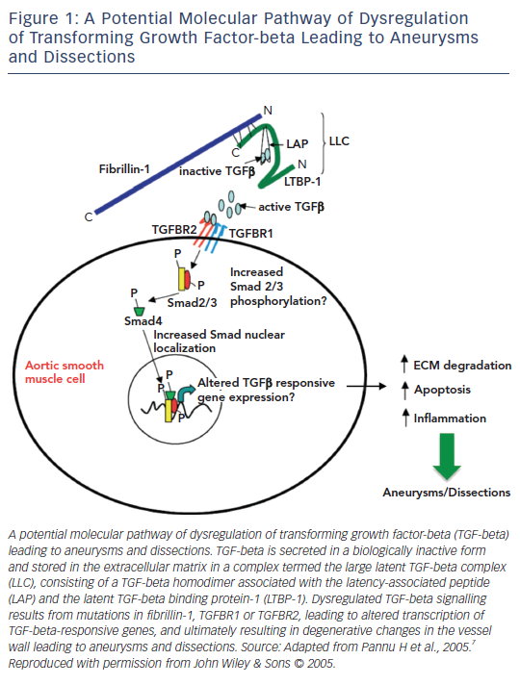
Isekame Y, Gati S, Aragon-Martin JA, Bastiaenen R, Kondapally Seshasai SR, Child A
Figure 1: A Potential Molecular Pathway of Dysregulation of Transforming Growth Factor-beta Leading to Aneurysms and Dissections
Citation: European Cardiology Review 2016;11(2):102–10
https://doi.org/10.15420/ecr/2016:19:2

