Slide 1
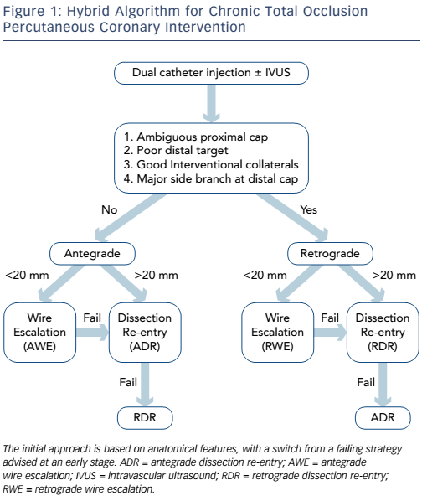
McNeice A, Ladwiniec A, Walsh SJ, Hanratty C
Figure 1: Hybrid Algorithm for Chronic Total Occlusion Percutaneous Coronary Intervention
Citation: European Cardiology Review, 2017;12(1):46–51
https://doi.org/10.15420/ecr.2016:25:2

