Slide 1
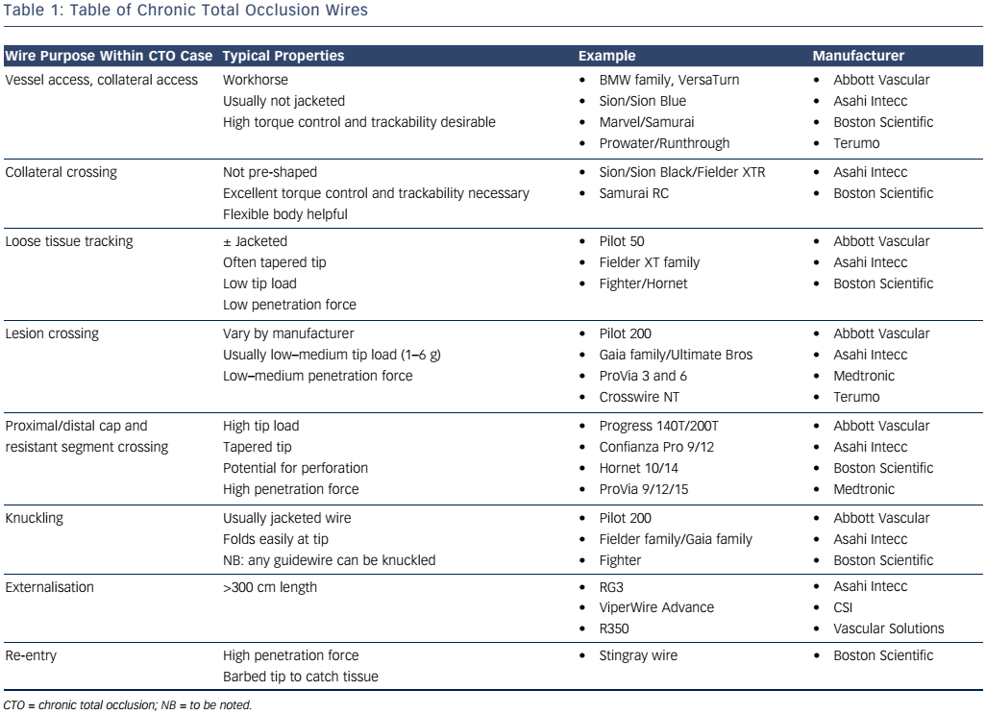
McNeice A, Ladwiniec A, Walsh SJ, Hanratty C
Table 1: Table of Chronic Total Occlusion Wires
Citation: European Cardiology Review, 2017;12(1):46–51
https://doi.org/10.15420/ecr.2016:25:2

