Slide 1
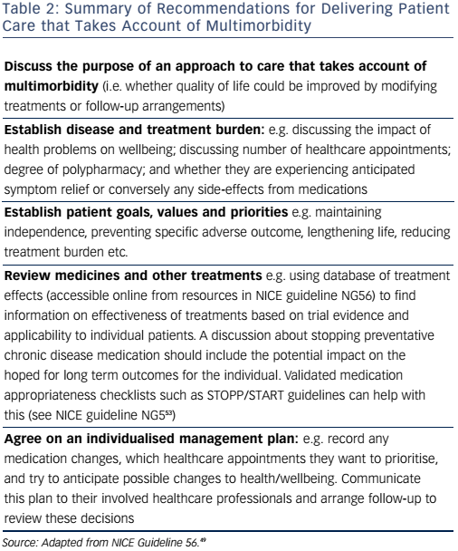
Hill E, Taylor J
Table 2: Summary of Recommendations for Delivering Patient Care that Takes Account of Multimorbidity
Citation: Cardiac Failure Review 2017;3(1):46–51.
https://doi.org/10.15420/cfr.2016:15:2

