Slide 1
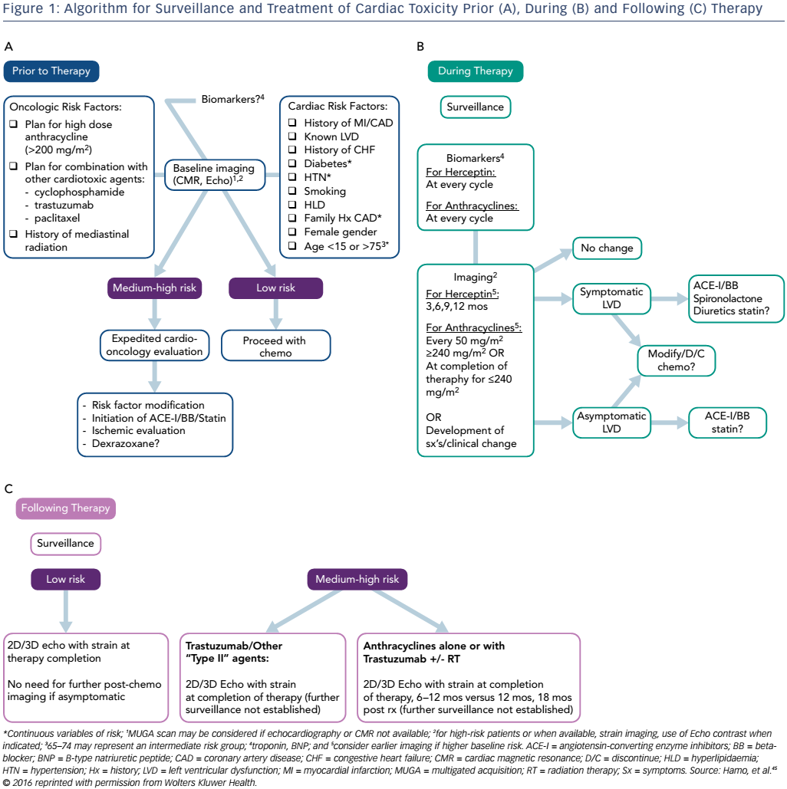
Hamo CE, Bloom MW
Figure 1: Algorithm for Surveillance and Treatment of Cardiac Toxicity Prior (A), During (B) and Following (C) Therapy
Citation: Cardiac Failure Review 2017;3(1):66–70.
https://doi.org/10.15420/cfr.2016:24:2

