Slide 1
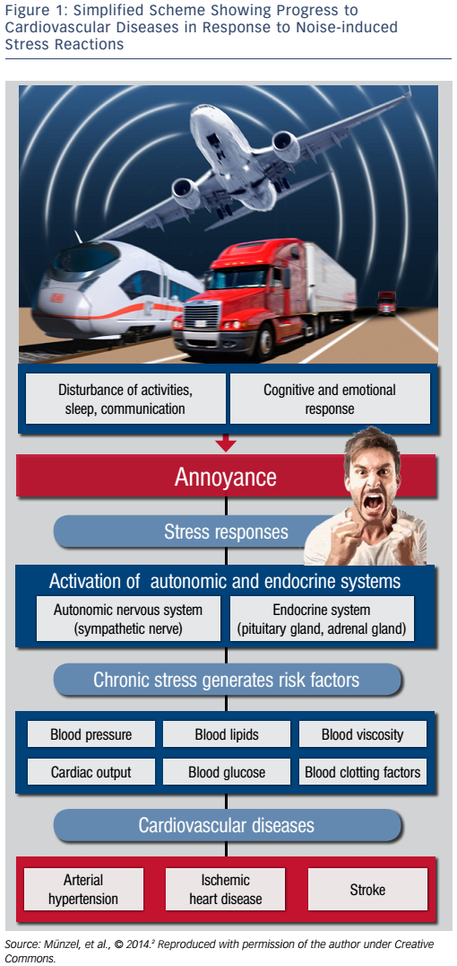
Münzel T, Sørensen M
Figure 1: Simplified Scheme Showing Progress to Cardiovascular Diseases in Response to Noise-induced Stress Reactions
Citation: European Cardiology Review 2017;12(1):26–9
https://doi.org/10.15420/ecr.2016:31:2

