Slide 1
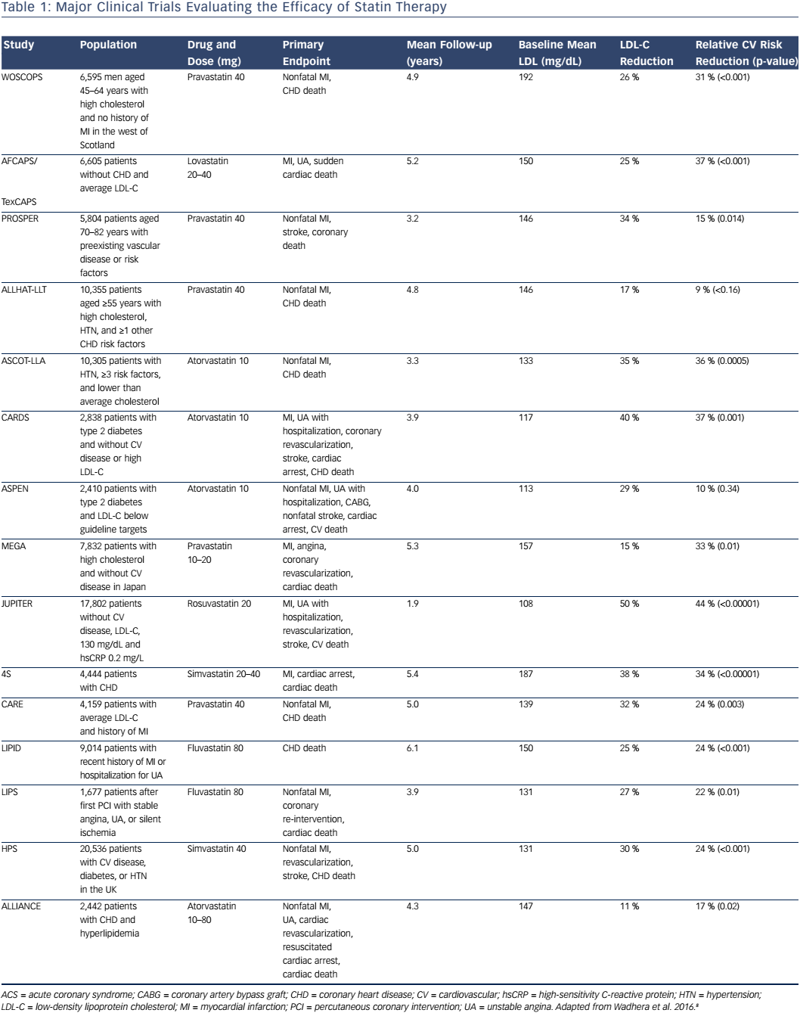
Carreras ET, Polk DM
Table 1: Major Clinical Trials Evaluating the Efficacy of Statin Therapy
Citation: US Cardiology Review 2017;11(1):10–5
https://doi.org/10.15420/usc.2016:9:2

