Slide 1
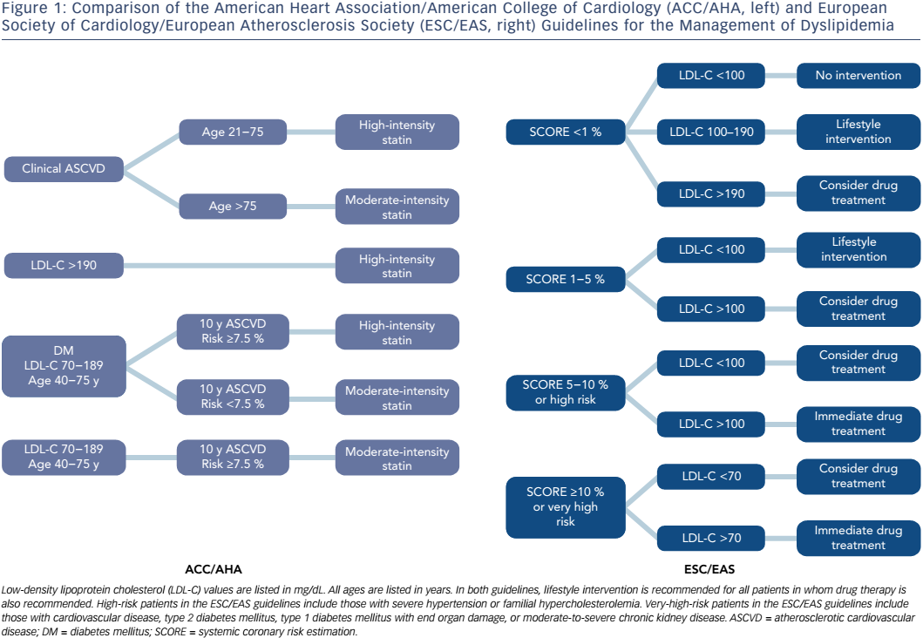
Carreras ET, Polk DM
Figure 1: Comparison of the American Heart Association/American College of Cardiology
Citation: US Cardiology Review 2017;11(1):10–5
https://doi.org/10.15420/usc.2016:9:2

