Slide 1
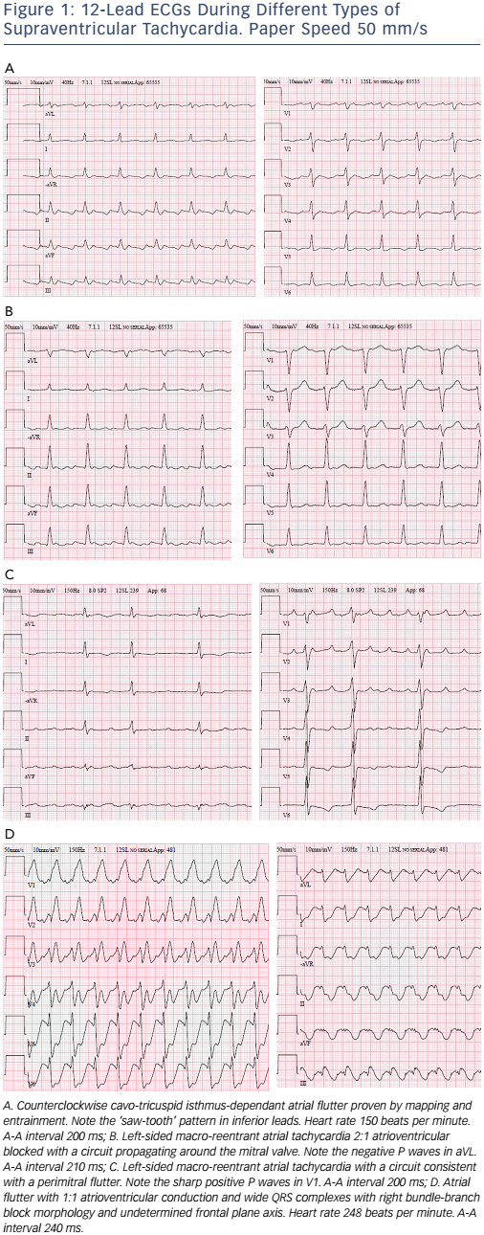
Blomström-Lundqvist C, Potpara TS, Malmborg H
12-Lead ECGSs
Citation: Arrhythmia & Electrophysiology Review 2017;6(2):42–9.
https://doi.org/10.15420/aer.2016:29:3

