Slide 1
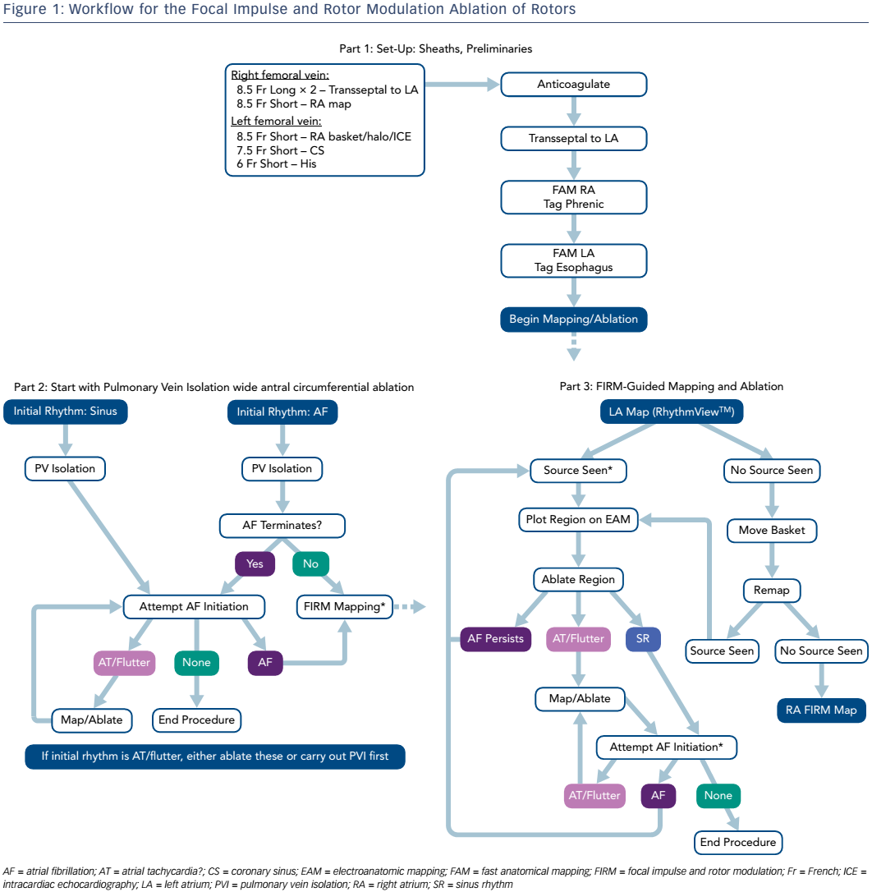
Miller JM
Figure 1: Workflow for the Focal Impulse and Rotor Modulation Ablation of Rotors
Citation: US Cardiology Review 2017;11(1):39–41
https://doi.org/10.15420/usc.2017:4:2

