Slide 1
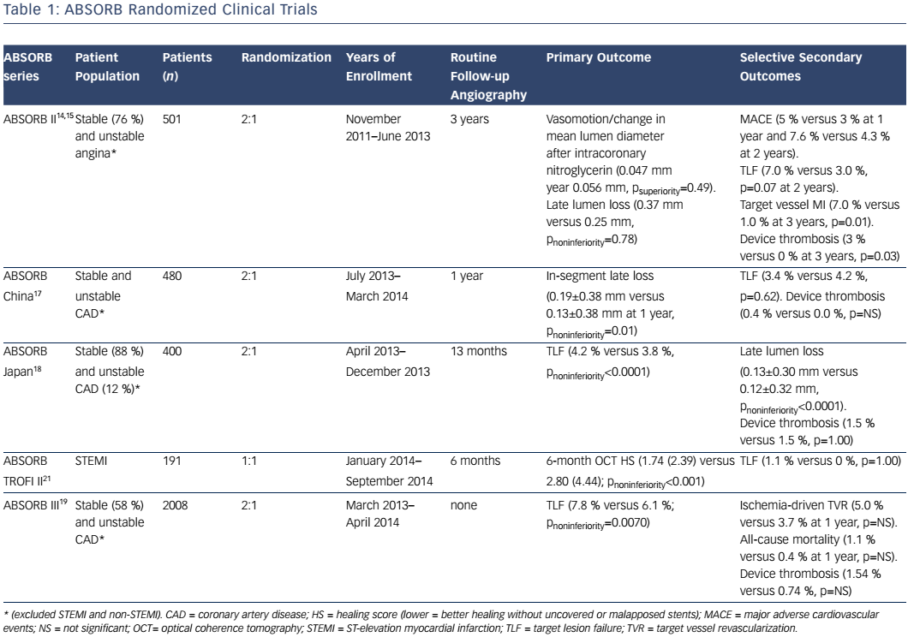
Yang X, Ahmed M, Cutlip DE
Table 1: ABSORB Randomized Clinical Trials
Citation: US Cardiology Review 2017;11(1):25–30
https://doi.org/10.15420/usc.2017:3:2

