Slide 1
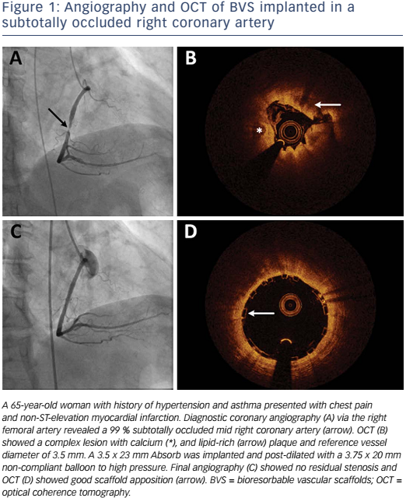
Yang X, Ahmed M, Cutlip DE
Figure 1: Angiography and OCT of BVS implanted in a subtotally occluded right coronary artery
Citation: US Cardiology Review 2017;11(1):25–30
https://doi.org/10.15420/usc.2017:3:2

