Slide 1
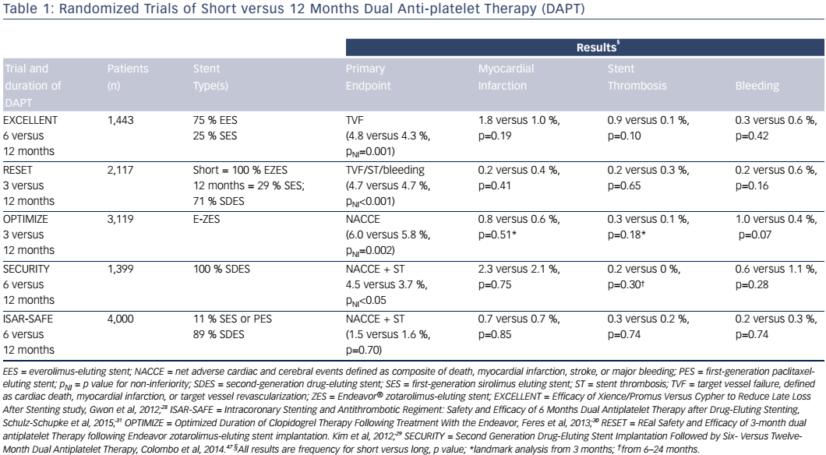
Cutlip DE
Table 1: Randomized Trials of Short versus 12 Months Dual Anti-platelet Therapy (DAPT)
Citation: US Cardiology Review 2017;11(1):31–6
https://doi.org/10.15420/usc.2017:7:2

