Slide 1
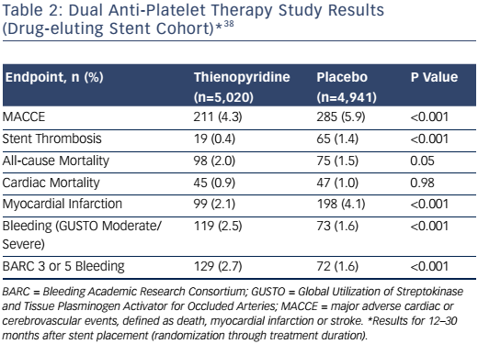
Cutlip DE
Table 2: Dual Anti-Platelet Therapy Study Results (Drug-eluting Stent Cohort)*38
Citation: US Cardiology Review 2017;11(1):31–6
https://doi.org/10.15420/usc.2017:7:2

