Slide 1
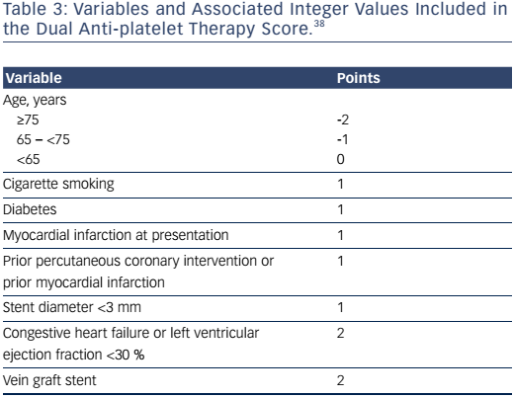
Cutlip DE
Table 3: Variables and Associated Integer Values Included in the Dual Anti-platelet Therapy Score.
Citation: US Cardiology Review 2017;11(1):31–6
https://doi.org/10.15420/usc.2017:7:2

