Slide 1
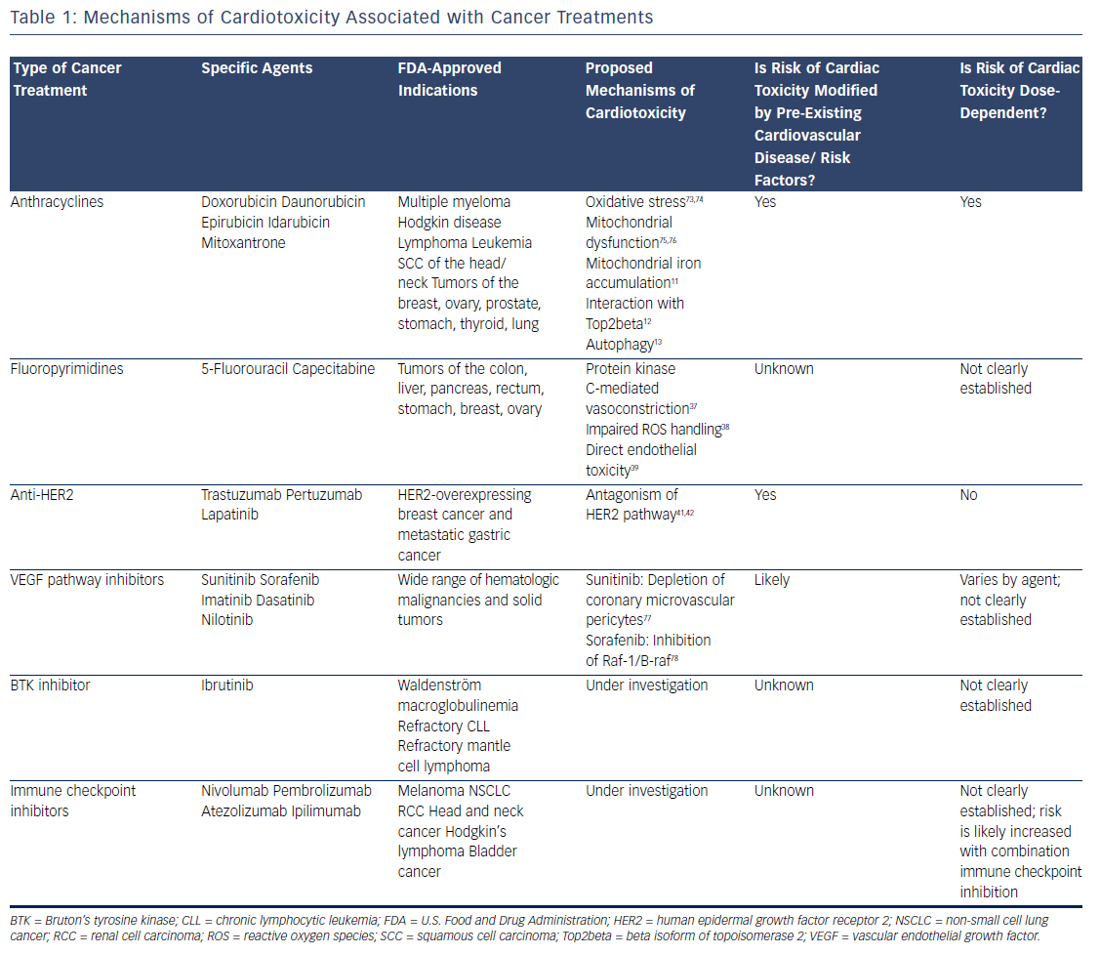
Asnani A, Peterson RT
Table 1: Mechanisms of Cardiotoxicity Associated with Cancer Treatments
Citation: US Cardiology Review 2017;11(1):20–4
https://doi.org/10.15420/usc.2017:2:2

