Slide 1
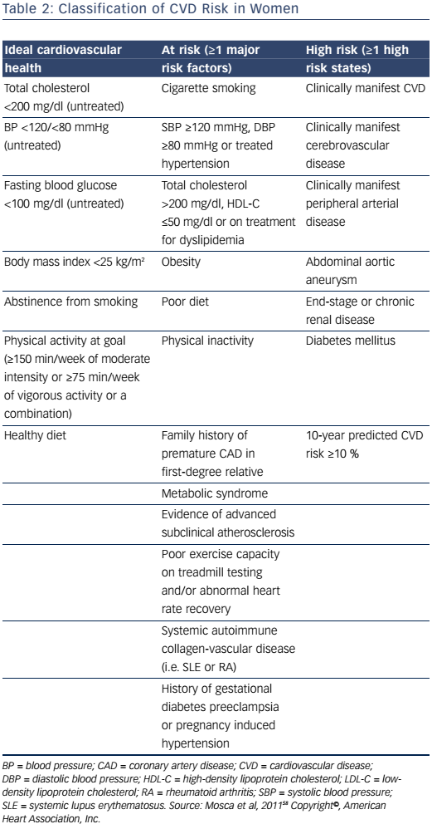
Isiadinso I, Wenger NK
Table 2: Classification of CVD Risk in Women
Citation: US Cardiology Review 2017;11(1):5–9
https://doi.org/10.15420/usc.2016:8:2

